Slide 1
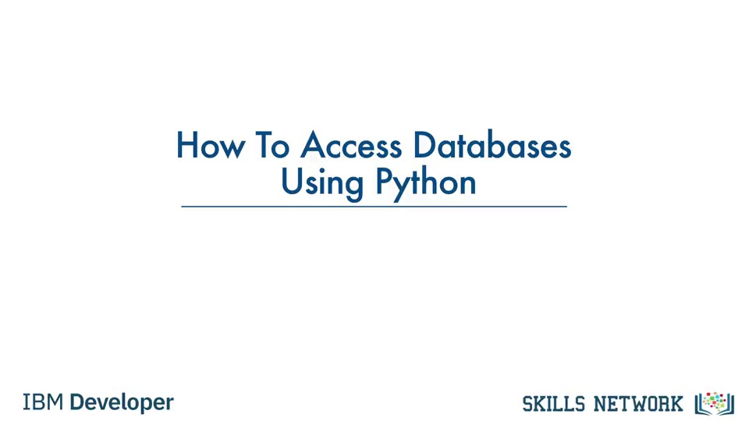

Slide 2
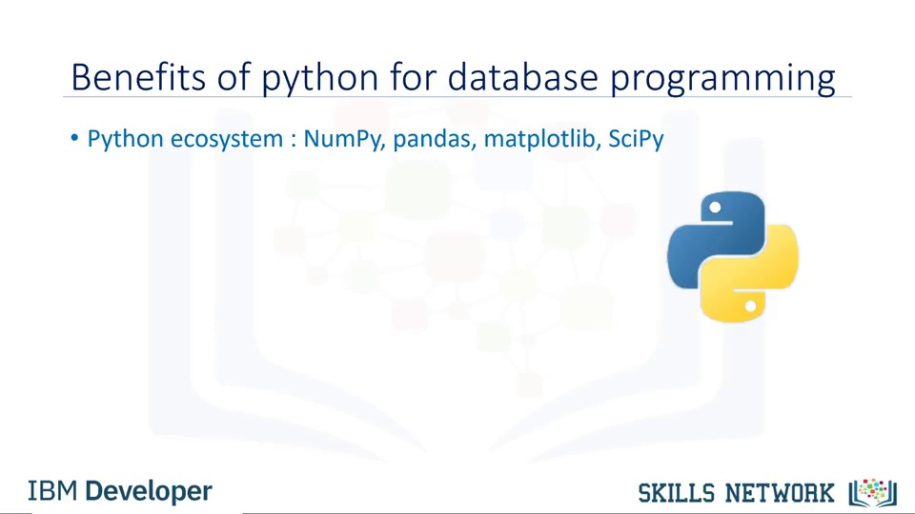

Slide 3
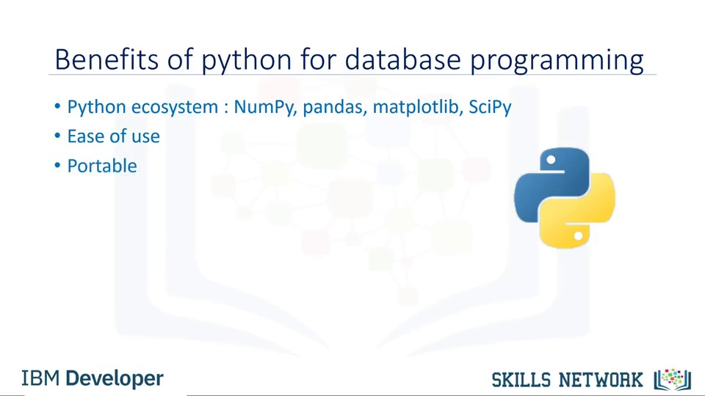

Slide 4
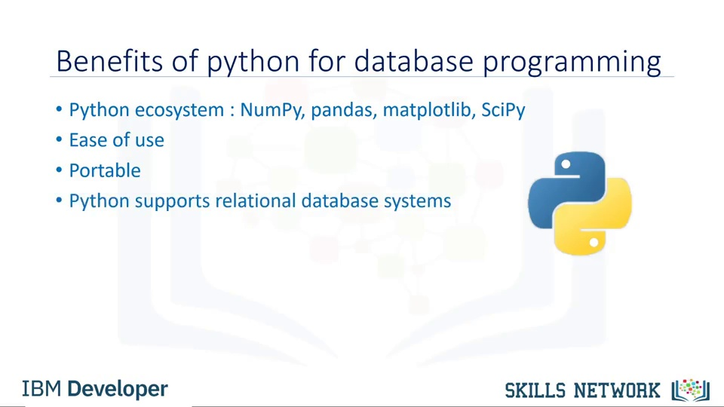

Slide 5
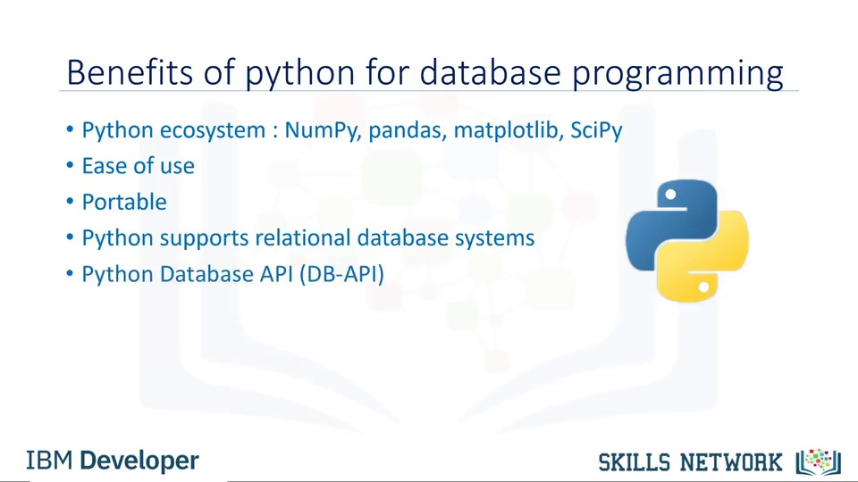

Slide 6
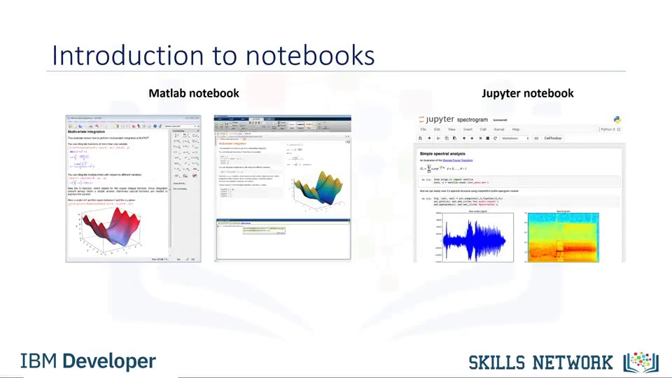
Notes:
Colab

Slide 7
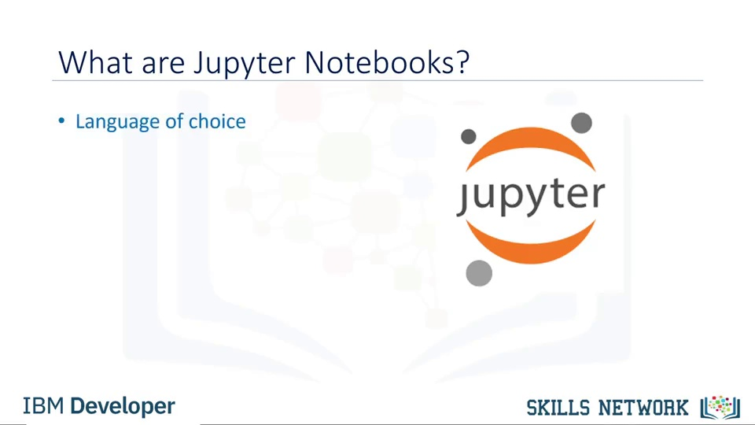

Slide 8
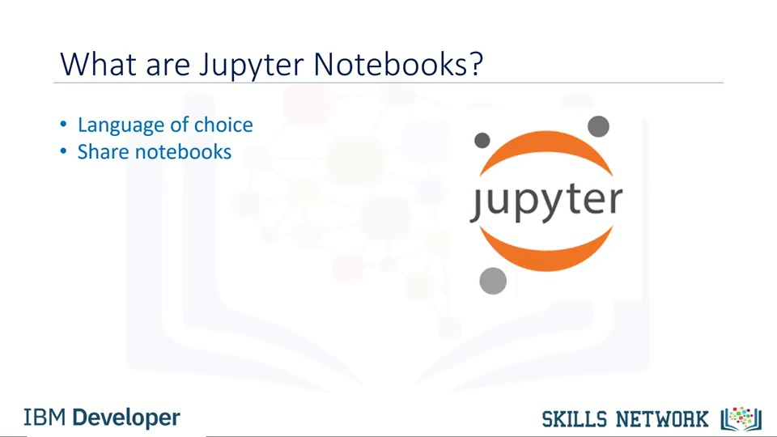

Slide 9
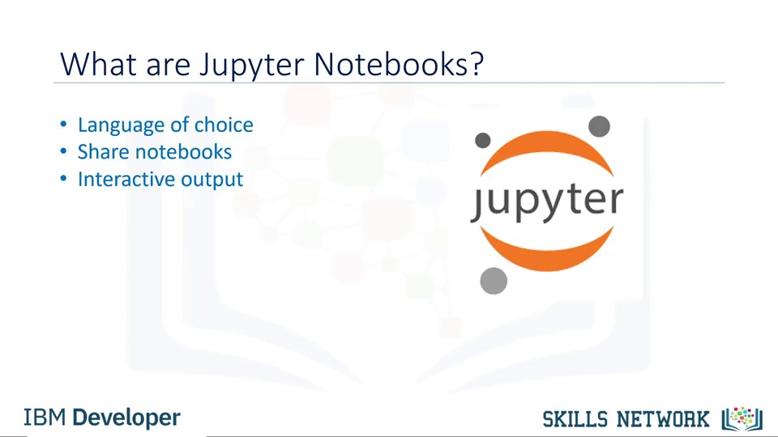

Slide 10
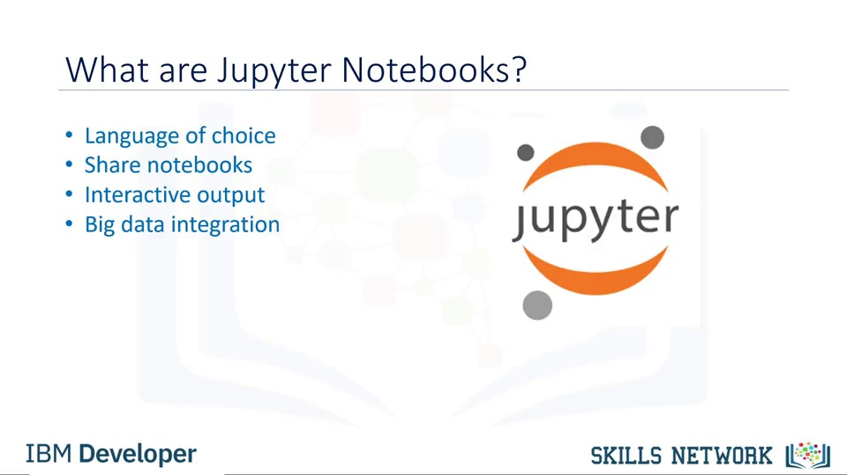

Slide 11
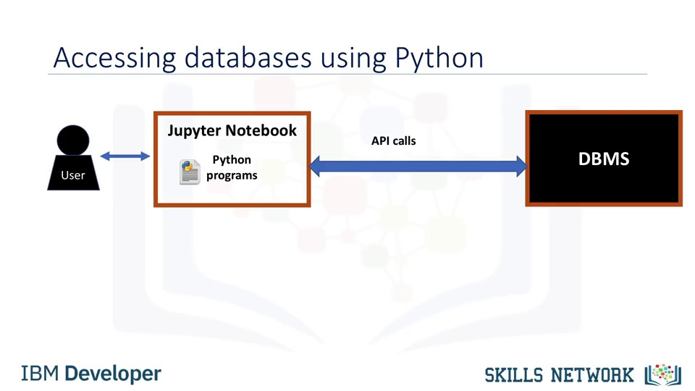

Slide 12
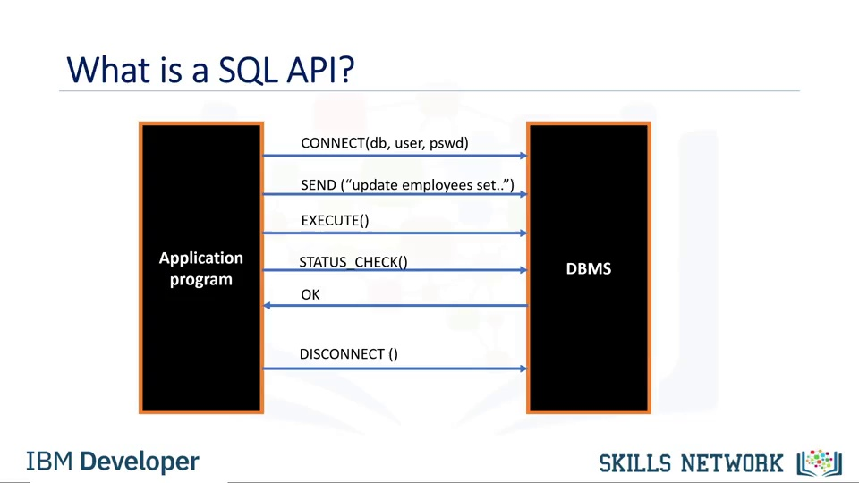

Slide 13
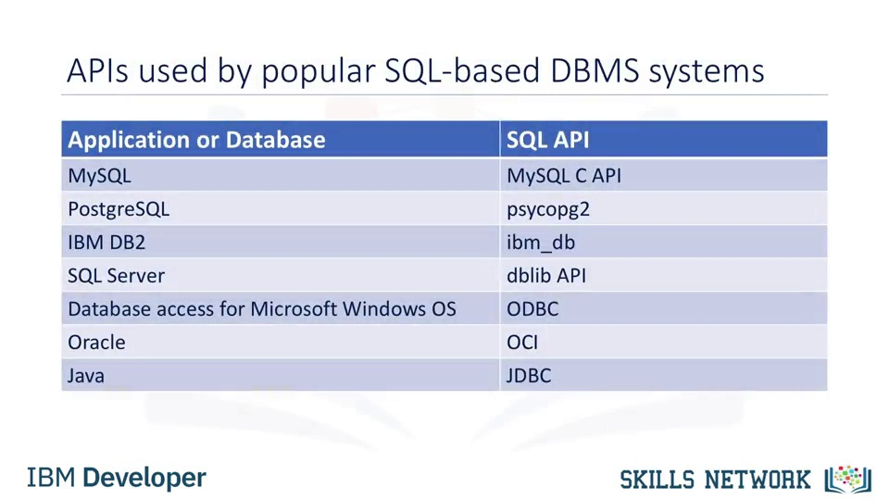

Slide 14
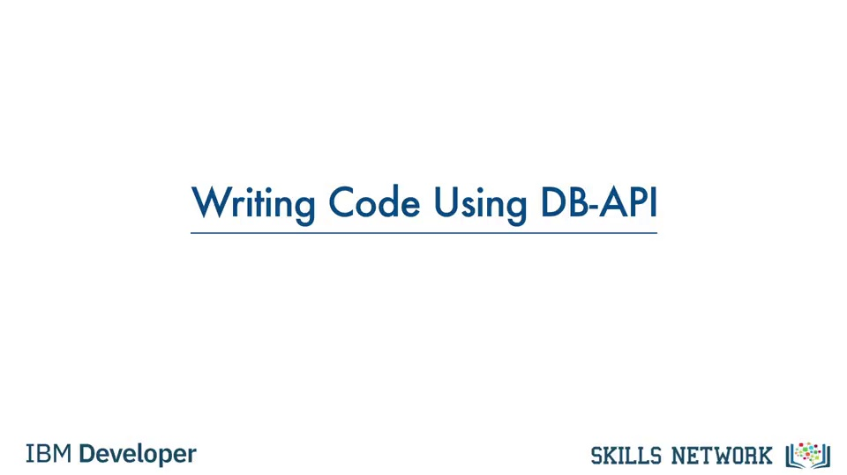

Slide 15
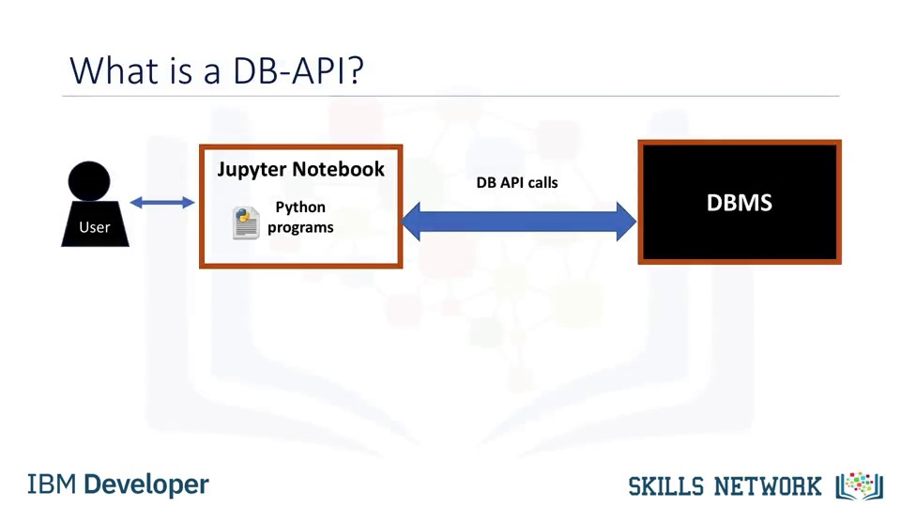

Slide 16
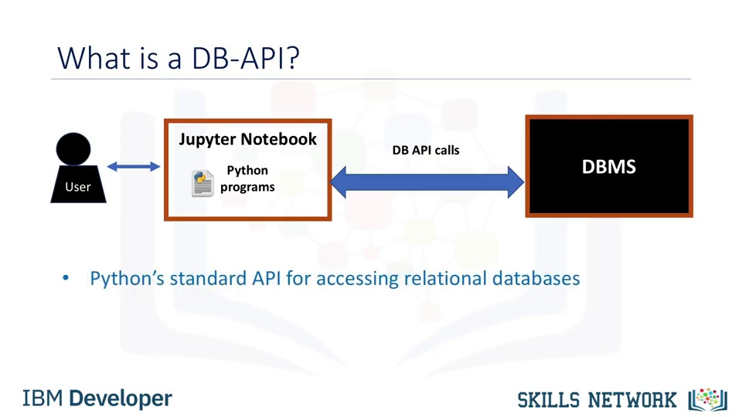

Slide 17
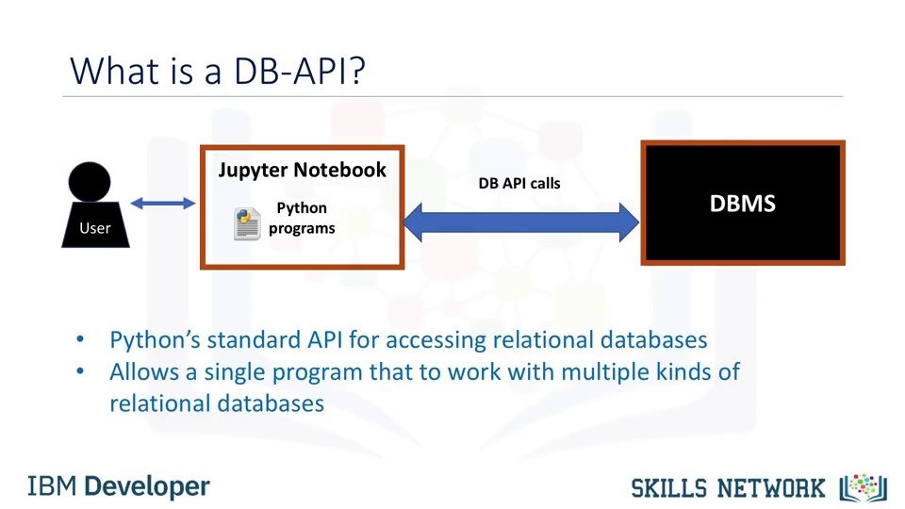

Slide 18
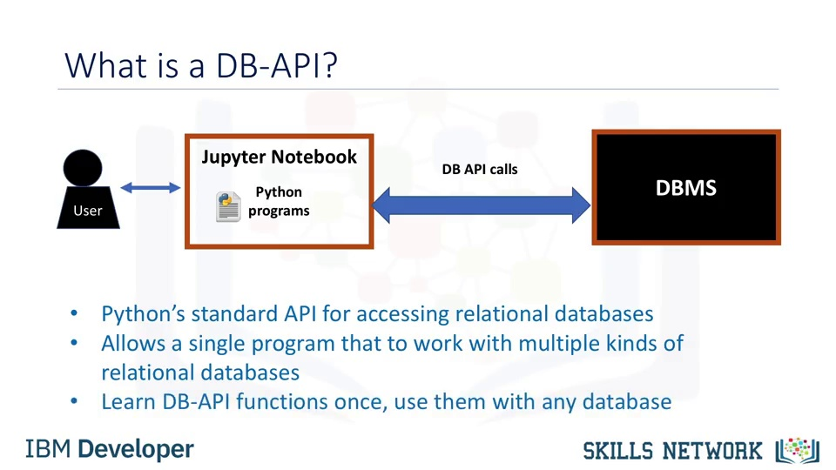

Slide 19
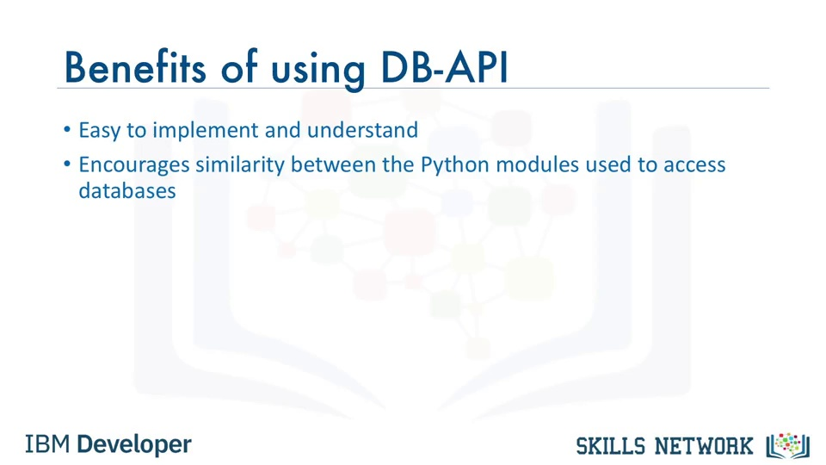

Slide 20
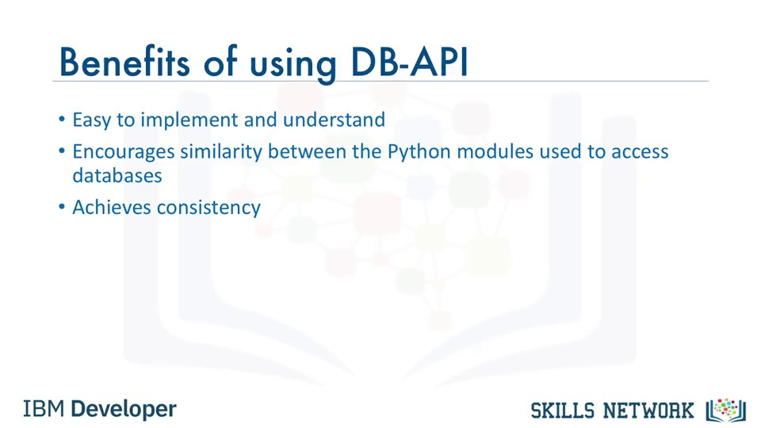

Slide 21
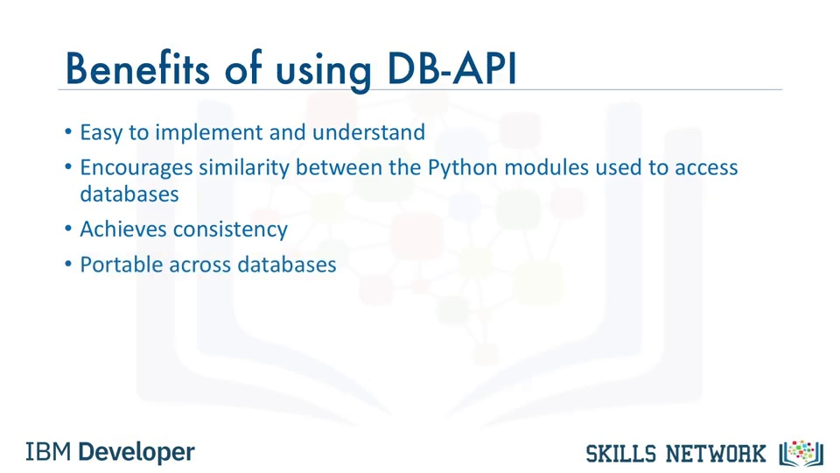

Slide 22
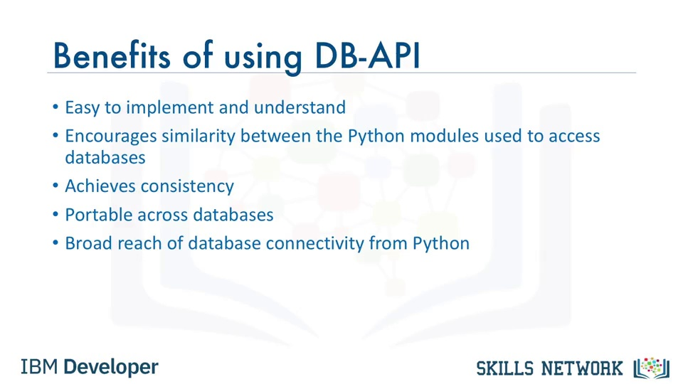

Slide 23
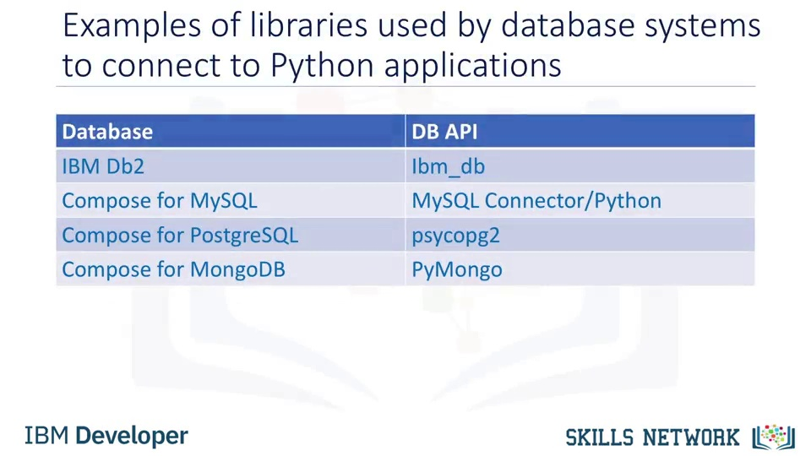

Slide 24
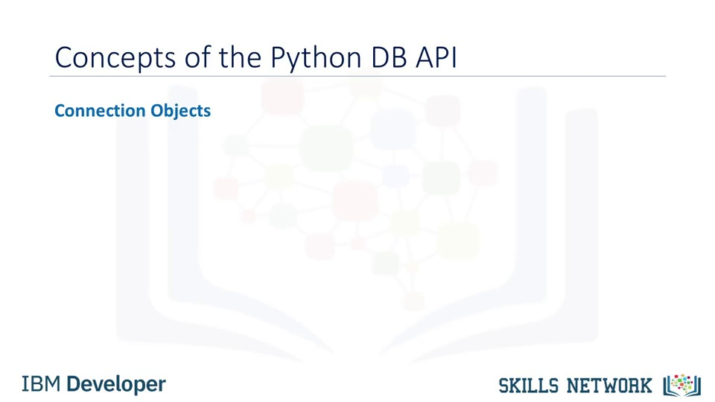

Slide 25
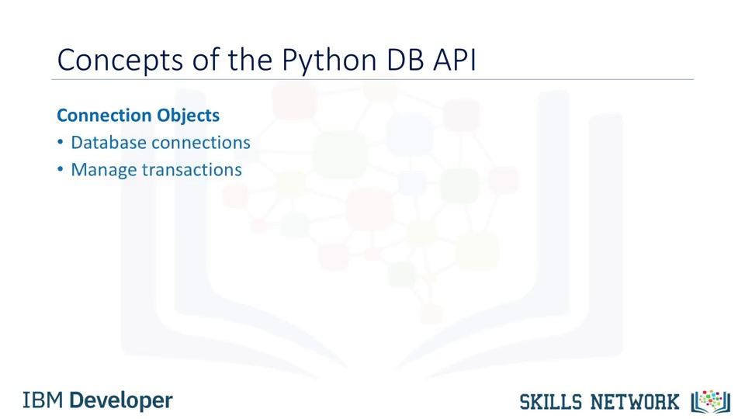

Slide 26
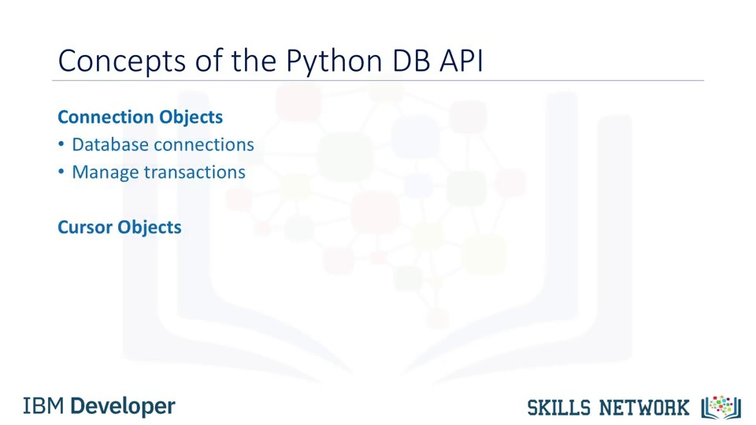

Slide 27
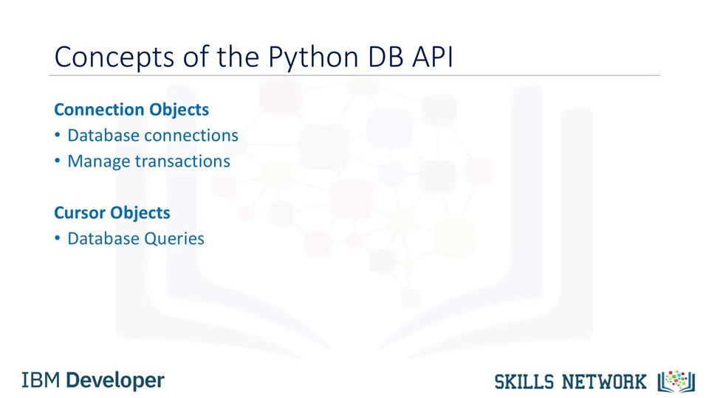

Slide 28
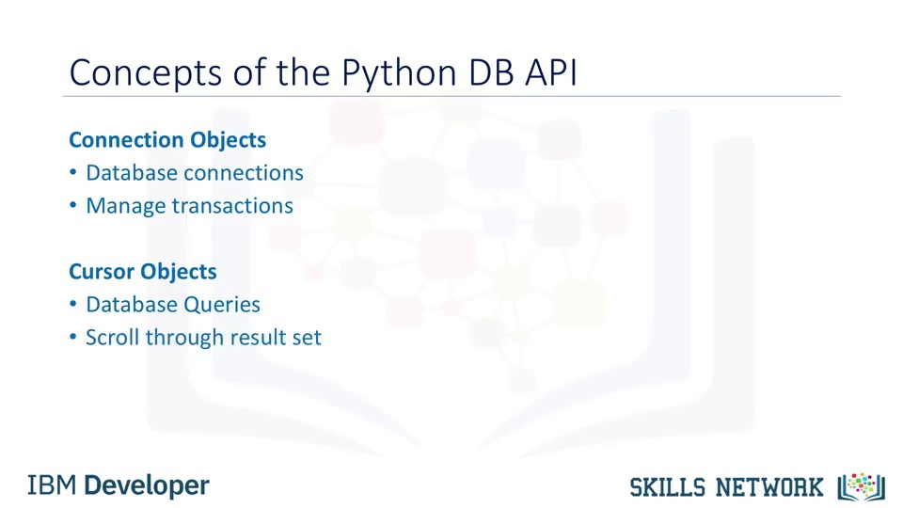

Slide 29
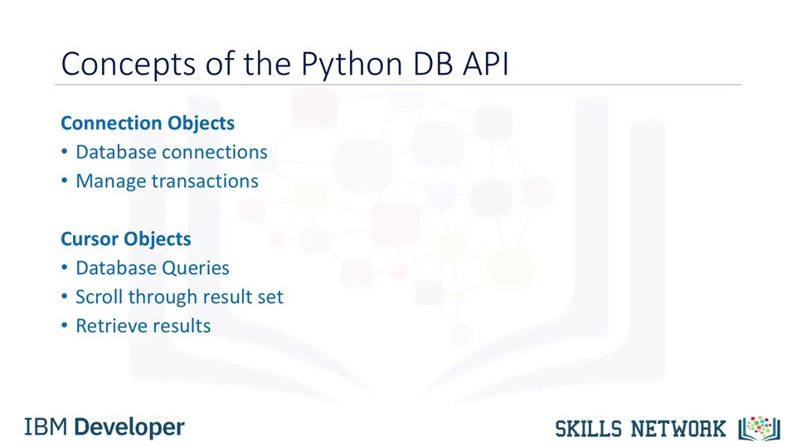
Notes:
The two main concepts in the Python DB-API are connection objects and query objects. Cursor objects are used to run queries. You open a cursor object and then run queries.

Slide 30
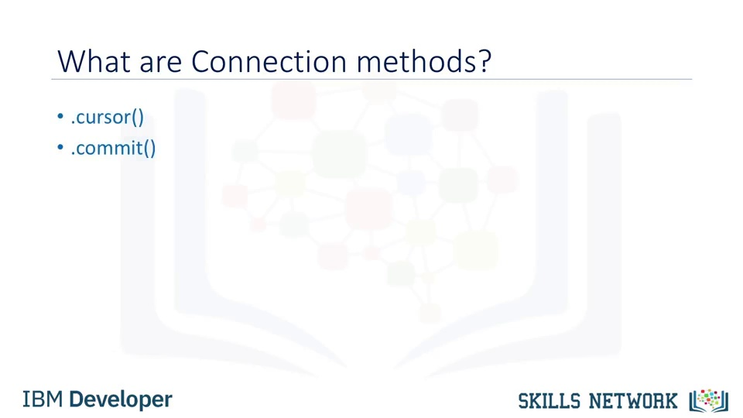
Notes:
Use the COMMIT statement to end your current transaction and make permanent all changes performed in the transaction.

Slide 31
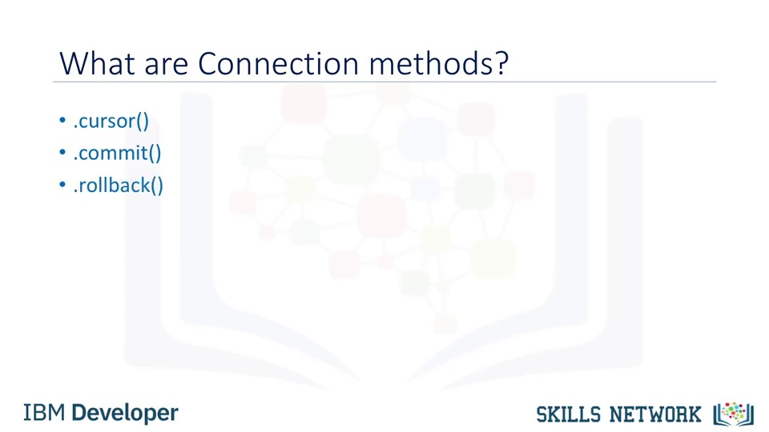
Notes:
A rollback is the operation of restoring a database to a previous state by canceling a specific transaction or transaction set.

Slide 32
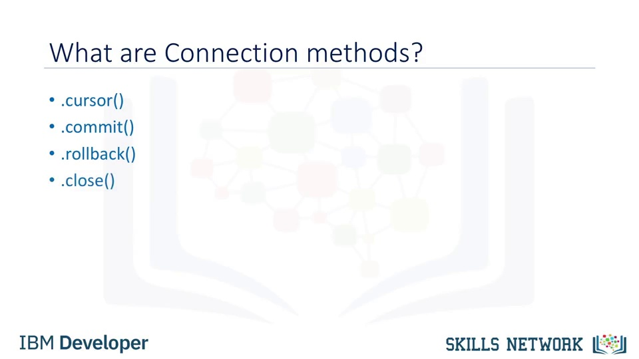

Slide 33
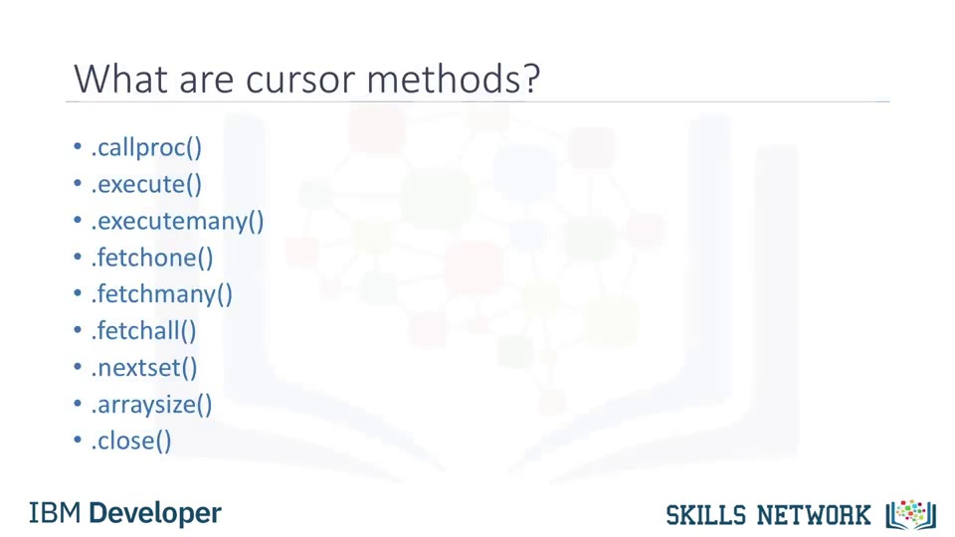
Notes:
CREATE PROCEDURE multiply(IN pFac1 INT, IN pFac2 INT, OUT pProd INT) BEGIN SET pProd := pFac1 * pFac2; END;
args = (5, 6, 0) # 0 is to hold value of the OUT parameter pProd >>> cursor.callproc('multiply', args) ('5', '6', 30L)
Nextset(() Makes the cursor skip to the next available result-set in a query that returns multiple result-sets.
arraysize()
insert into t values ( 1, '{ "arr" : [1, 2, 3] }'); I
nsert into t values ( 2, '{ "arr" : [1, 2, 3, 4, 5] }')

Slide 34
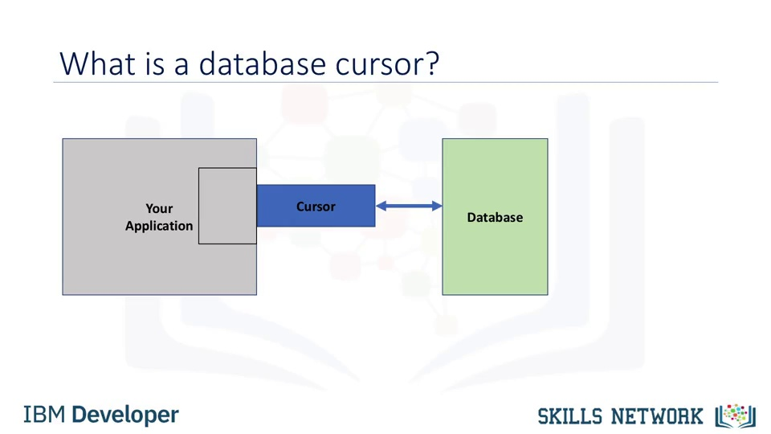

Slide 35


Slide 36


Slide 37
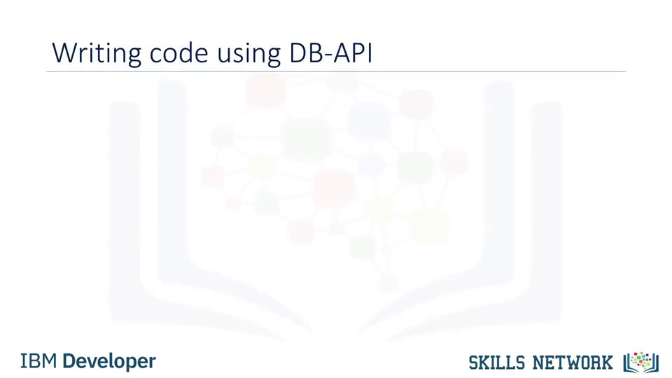

Slide 38
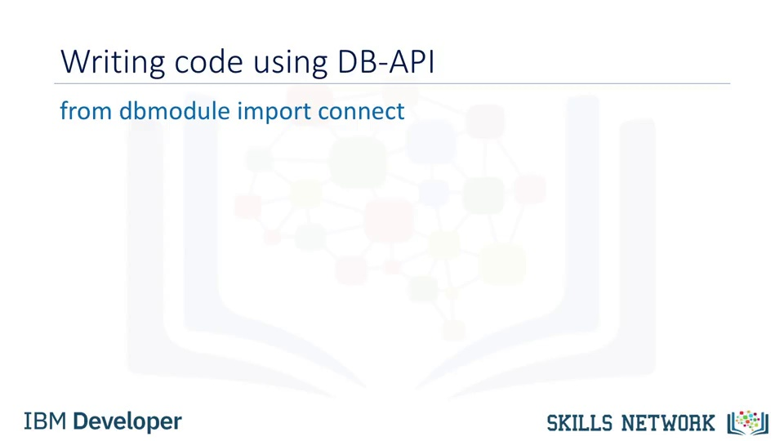

Slide 39
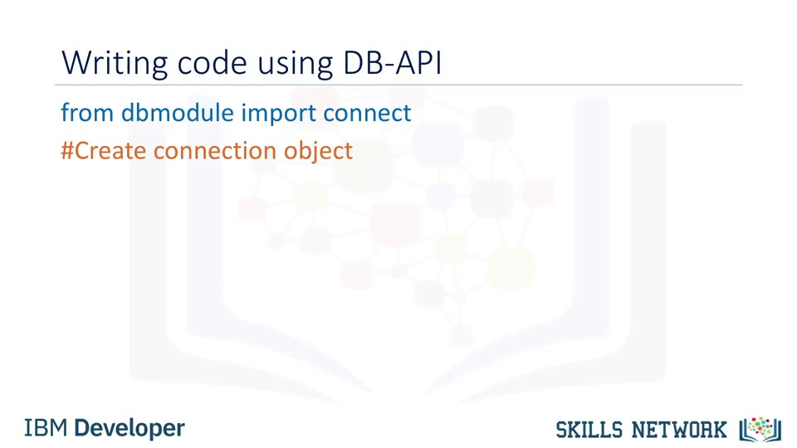

Slide 40
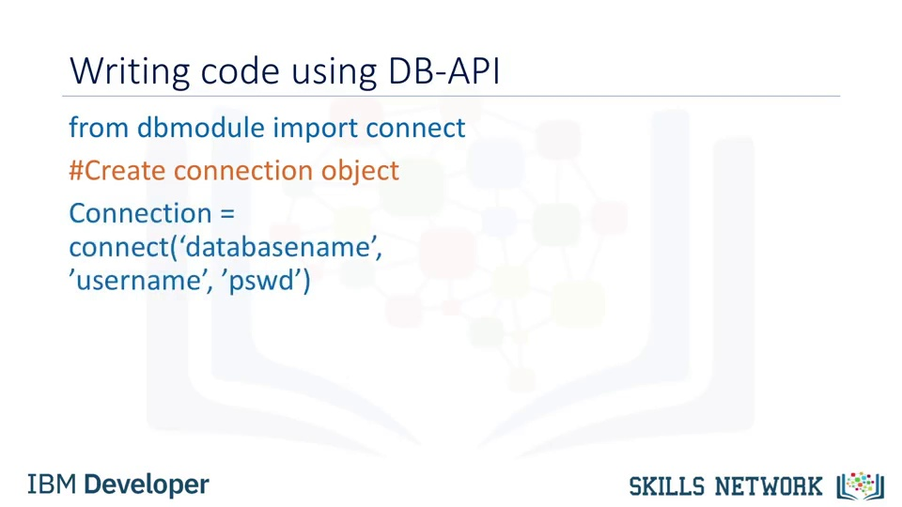

Slide 41
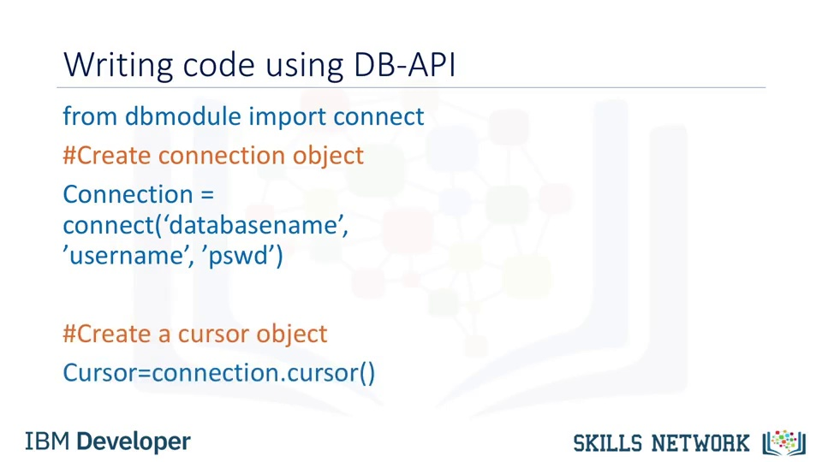

Slide 42
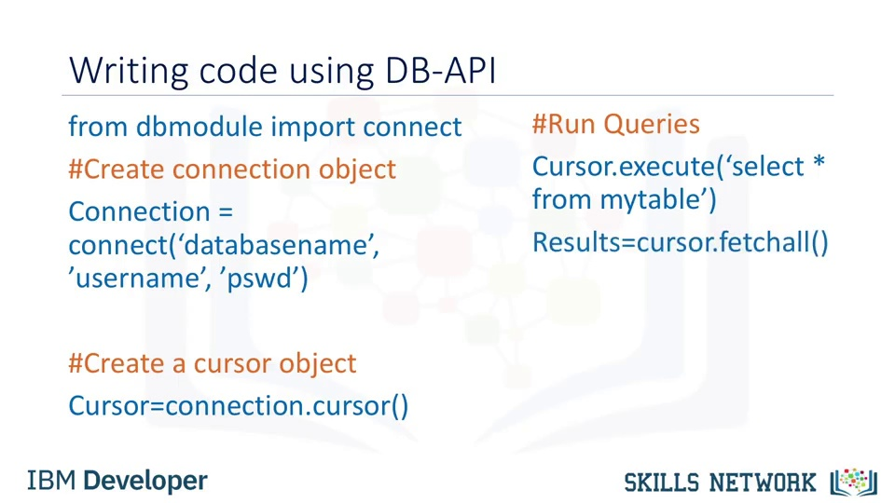

Slide 43
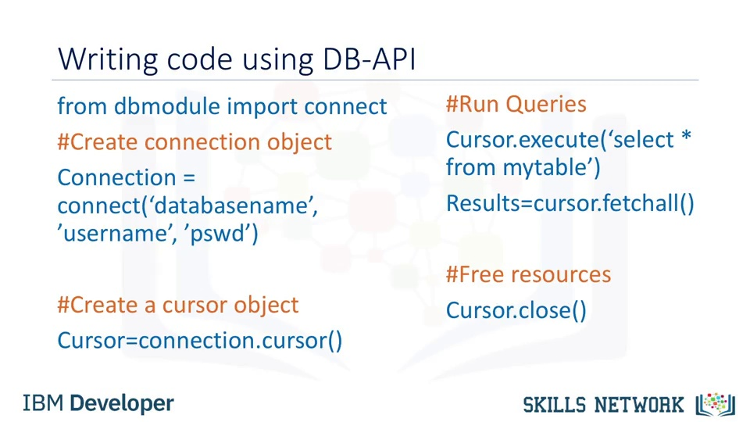

Slide 44
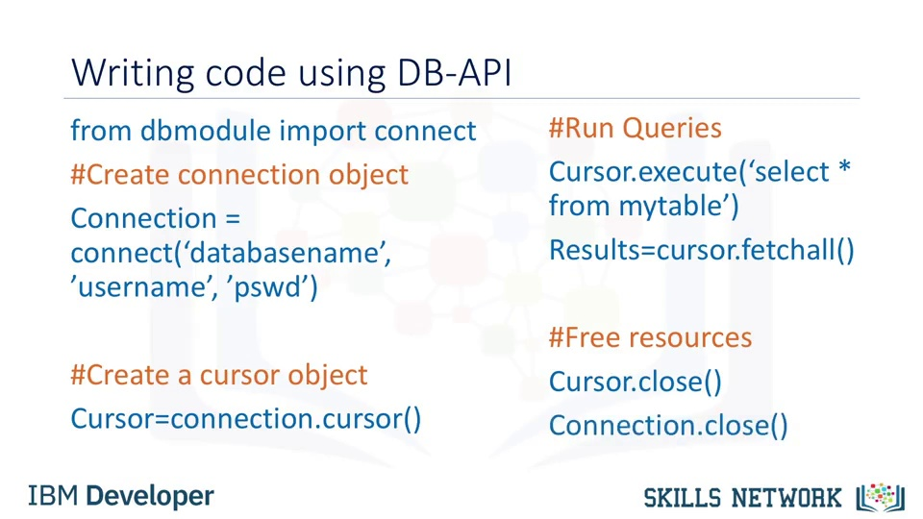

Slide 45
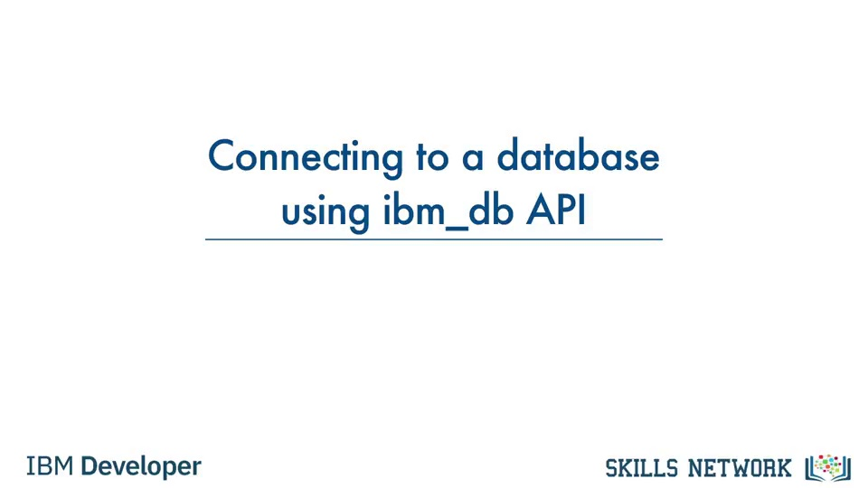

Slide 46
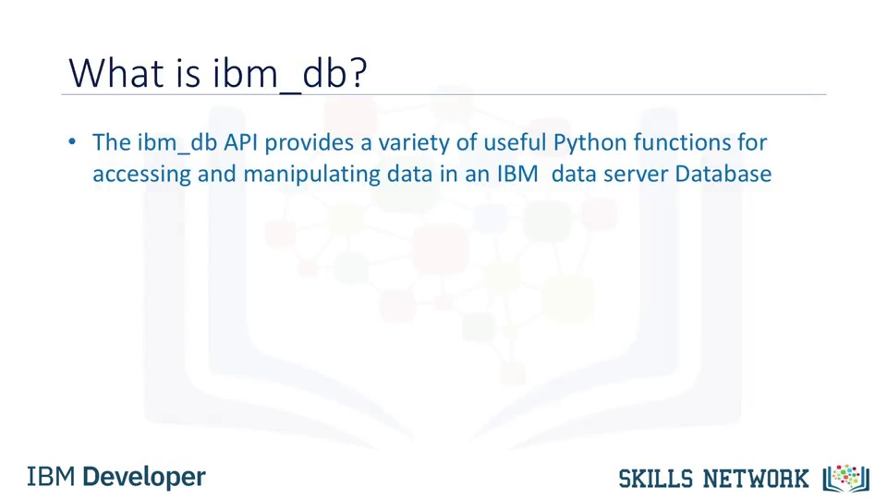

Slide 47
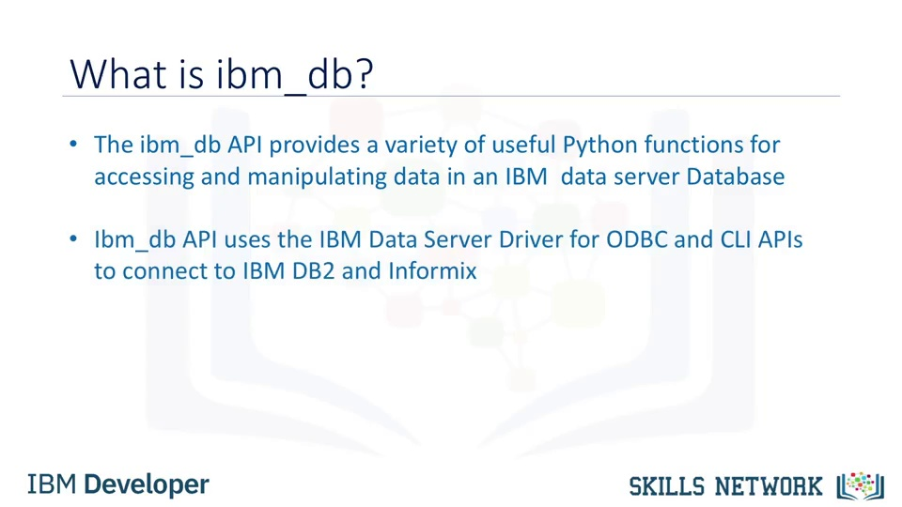

Slide 48
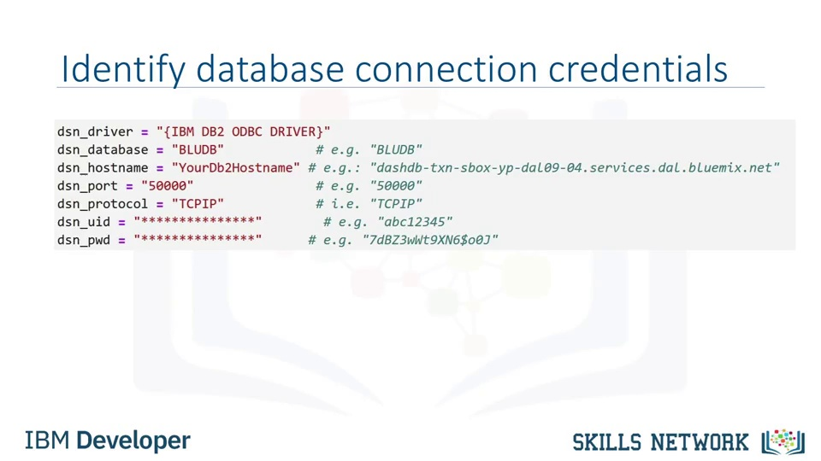

Slide 49
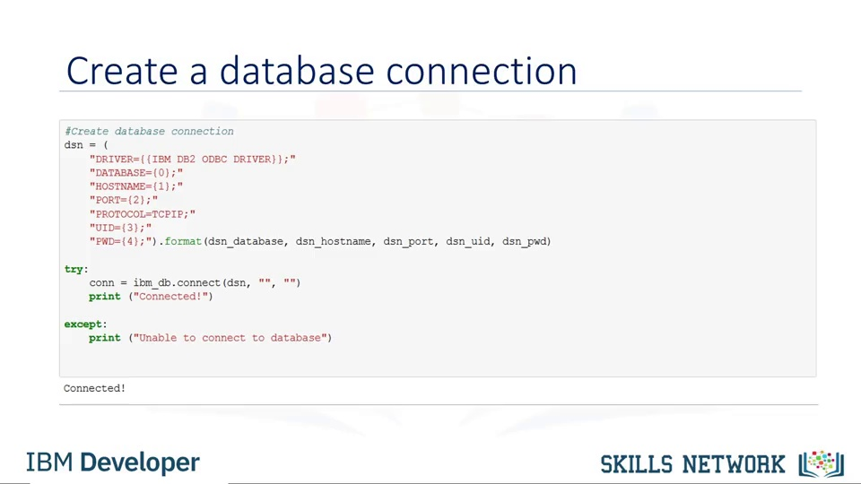

Slide 50
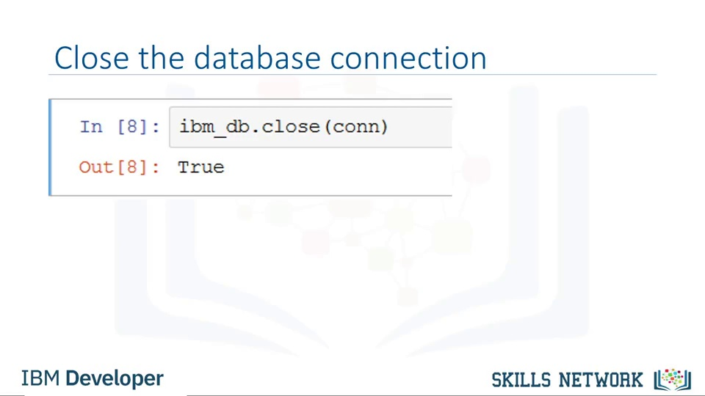

Slide 51
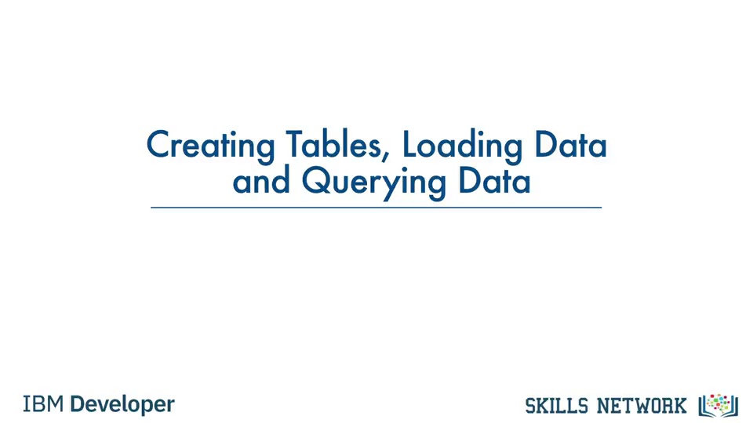

Slide 52
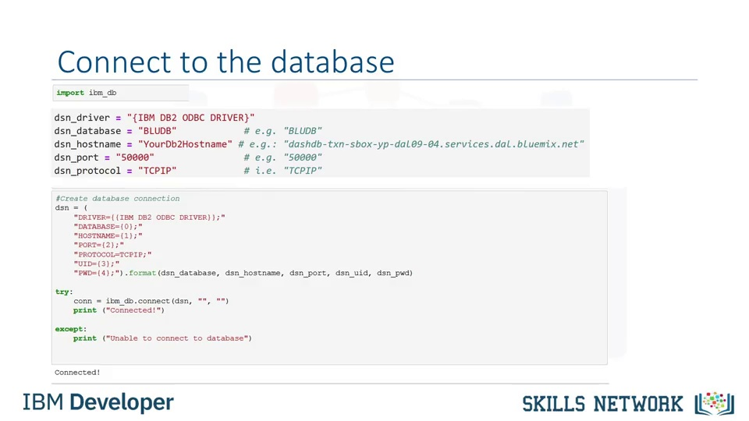

Slide 53


Slide 54


Slide 55


Slide 56


Slide 57


Slide 58


Slide 59


Slide 60


Slide 61


Slide 62


Slide 63


Slide 64


Slide 65


Slide 66


Slide 67


Slide 68


Slide 69


Slide 70


Slide 71


Slide 72


Slide 73


Slide 74


Slide 75


Slide 76


Slide 77


Slide 78


Slide 79


Slide 80


Slide 81


Slide 82


Slide 83


Slide 84


Slide 85


Slide 86


Slide 87


Slide 88


Slide 89


Slide 90


Slide 91


Slide 92


Slide 93


Slide 94


Slide 95


Slide 96


Slide 97


Slide 98


Slide 99


Slide 100


Slide 101


Slide 102


Slide 103


Slide 104


Slide 105


Slide 106

Notes:
The magic commands, or magics, are handy commands built into the IPython kernel that make it easy to perform particular tasks, for example, interacting Python’s capabilities with the operating system, another programming language, or a kernel.
IPython provides two categories of magics: line magics and cell magics. Line magics operate on a single line of input and are denoted by a single percent sign (%). Cell magics can operate on multiple lines of input and are denoted by two percent signs (%%).

